Slide 1

CS401 Modern Programming Practices (MPP) Dr. Shafqat Ali Shad
MAHARISHI UNIVERSITY of MANAGEMENT
Engaging the Managing Intelligence of Nature
Computer Science Department

Slide 2
© 2015
Maharishi University of Management, Fairfield, Iowa
All rights reserved. No part of this slide presentation may be reproduced or utilized in any form or by any means, electronic or mechanical, including photocopying or recording, or by any information storage and retrieval system, without permission in writing from Maharishi University of Management.

Slide 3
Lecture 9: The Stream API
Solving Problems by Engaging Deeper Values of Intelligence

Slide 4
Wholeness Statement
The stream API is an abstraction of collections that supports aggregate operations like filter and map. These operations make it possible to process collections in a declarative style that supports parallelization, compact and readable code, and processing without side effects. Deeper laws of nature are ultimately responsible for how things appear in the world. Efforts to modify the world from the surface level only lead to struggle and partial success. Affecting the world by accessing the deep underlying laws that structure everything can produce enormous impact with little effort. The key to accessing and winning support from deeper laws is going beyond the surface of awareness to the depths within.

Slide 5
What Are Streams and Why Are They Used?
A stream is a way of representing data in a collection (and in a few other data structures) which supports functional-style operations to manipulate the data. From the API docs: A stream is “a sequence of elements supporting sequential and parallel aggregate operations.” Streams provide new ways of accessing and extracting data from Collections.
To understand why they are used, consider the following task as an example: Given a list of words (say from a book), count how many of the words have length > 12.

Slide 6
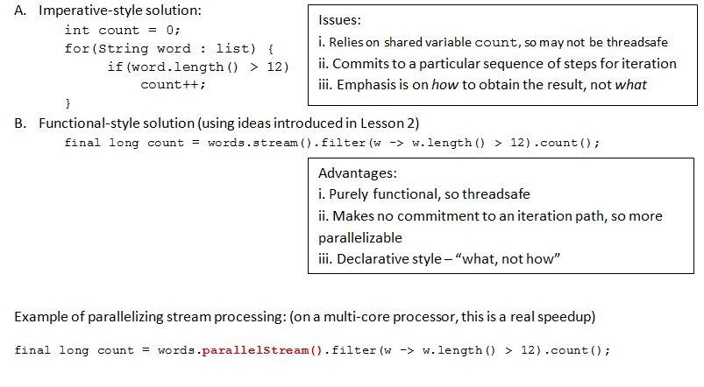
What Are Streams and Why Are They Used?
Notes:
Stream operations are either intermediate or terminal. Intermediate operations return a stream so we can chain multiple intermediate operations without using semicolons. Terminal operations are either void or return a non-stream result. In the above example filter, mapand sorted are intermediate operations whereas forEach is a terminal operation.

Slide 7
Facts About Streams
Streams do not store the elements they operate on. Typically they are stored in an underlying collection, or they may be generated on demand.
Stream operations do not mutate their source. Instead, they return new streams that hold the result.
Stream operations are lazy whenever possible. So they are not executed until their result is needed. Example: In previous example, if you request only the first 5 words of length > 12, the filter method will stop filtering after the fifth match. This makes it possible to have (potentially) infinite streams.
Java Implementation. The methods on the Stream interface are implemented by the class ReferencePipeline. The method implementations involve a combination of technical operations internal to the stream package.

Slide 8
Template for Using Streams
Create a stream. Typically, the stream is obtained from some kind of Collection, but streams can also be generated from scratch.
Create a pipeline of operations. Each of the operations transforms the stream in some way, and returns a new stream.
End with a terminal operation. The terminal operation produces a result. It also forces lazy execution of the operations that precede it.
NOTE: After a terminal operation on a pipeline of operations on a stream, the stream can no longer be used. You have to be careful not to attempt to re-use a stream after a terminal operation has been called on it.
Example from Lesson 8:
List<String> startsWithLetter = list.stream() //create the stream
.filter(name -> name.startsWith(letter)) //build pipeline
.collect(Collectors.toList()); //invoke terminal operatio

Slide 9
Ways of Creating Streams
Obtain a Stream from any Collection object with a call to stream() (this default method was added to the Collection interface in Java 8)
Get a Stream from an array like this: int[] arrOfInt = {1, 3, 5, 7};
Stream<Integer> strOfInt = Stream.of(arrOfInt);
Get a Stream from any sequence of arguments: (the of method accepts a varargs argument – for a review of varargs see https://docs.oracle.com/javase/1.5.0/docs/guide/language/varargs.html)
Stream<String> song = Stream.of(“gently”, “down”, “the”, “stream”);

Slide 10
Ways of Creating Streams
Two ways to obtain infinite streams: generate and iterate (remember stream operations are lazy)
The generate function accepts a Supplier<T> argument; in practice, this means that it accepts functions (lambda expressions) with zero parameters.
interface Supplier<T>
{
T get();
}
Example: Stream of constant values (“Echo”): Stream<String> echoes = Stream.generate(() -> “Echo”);
Example: Stream of random numbers: Stream<Double> randoms = Stream.generate(Math::random);

Slide 11
Ways of Creating Streams
The iterate function accepts a seed value (of type T) and a UnaryOperator<T> argument.
interface UnaryOperator<T> {
T apply(T t);
}
Example: Stream of natural numbers: (Here, T is BigInteger) Stream<BigInteger> naturalNums = Stream.iterate(BigInteger.ONE, n -> n.add(BigInteger.ONE))
Can do the same thing with Integers instead of BigIntegers, but not with ints (we discuss Streams based on primitives later in the lesson)
Stream<Integer> stream2 = Stream.iterate(1, n -> n + 1));
Notes:
Interface UnaryOperator<T>
Type Parameters:T - the type of the operand and result of the operatorAll Superinterfaces:Function<T,T>Functional Interface:This is a functional interface and can therefore be used as the assignment target for a lambda expression or method reference.
Besides regular object streams Java 8 ships with special kinds of streams for working with the primitive data types int, long and double. As you might have guessed it's IntStream,LongStream and DoubleStream.

Slide 12
Extracting Substreams and Combining Streams
stream.limit(n). The call stream.limit(n) returns a new stream that ends after n elements (or when the original stream ends if it is shorter). This method is useful for cutting infinite streams down to size.
Example: Stream<Double> randoms = Stream.generate(Math::random).limit(100);
yields a stream with 100 random numbers.
stream.skip(n) The call stream.skip(n) discards the first n elements.
stream.concat(Stream) You can concatenate two streams with the static concat method of the Stream class:
Example:
Stream<Character> combined =
Stream.concat(characterStream("Hello"),
characterStream("World"));
// Yields the stream ['H', 'e', 'l', 'l', 'o', 'W', 'o', 'r', 'l', 'd']

Slide 13
Extracting Substreams and Combining Streams
Note: For concatenation, the first stream should not be infinite—otherwise the second wouldn’t ever be accessed.
Here is the characterStream method – transforms a String into a Stream of Characters:
public static Stream<Character> characterStream(String s) {
List<Character> result = new ArrayList<>();
for (char c : s.toCharArray()) result.add(c);
return result.stream();}

Slide 14
Stream Operations: Use filter to Extract a Substream that Satisfies Specified Criteria
filter accepts as its argument a Predicate<T> interface.
interface Predicate<T> {
boolean test(T t);
}
Recall the earlier example: final long count = words.stream().filter(w -> w.length() > 12).count();
The return value of filter is another Stream, so filters can be chained: Recall Lab 8:
words.stream() .filter(name -> name.contains(""+c))
.filter(name -> !name.contains(""+d))
.filter(name -> name.length()==len)
.count();

Slide 15
Stream Operations: Use map to Transform Each Element of a Substream
map accepts a Function interface. Typical special case of the Function interface is
interface Function<T,R> {
R apply(T t);
}
A map accepts this type of Function interface and returns a Stream<R> -- a stream of values each having type R, which is the return type of the Function interface. maps can therefore be chained.
Example: Given a list : List<Integer> list
of Integers, obtain a list of Strings representing those Integers (T is Integer, R is String)
List<String> strings = list.stream() .map(x -> x.toString()) .collect(Collectors.toList())

Slide 16
Application: Using map with Constructor References
Class::new is a fourth type of method reference, where the method is the new operator. Examples:
Button::new - compiler must select which Button constructor to use; determined by context. When used with map, the Button(String) constructor would be used, and the constructor reference Button::new resolves to the following lambda: str -> new Button(str) (which realizes a Function interface, as required by map).
List<String> labels = ...;
Stream<Button> stream = labels.stream().map(Button::new);
List<Button> buttons = stream.collect(Collectors.toList());
In this example, map passed each String in labels into the Button constructor and creates in this way a stream of labeled buttons, which are then collected together into a list at the end.

Slide 17
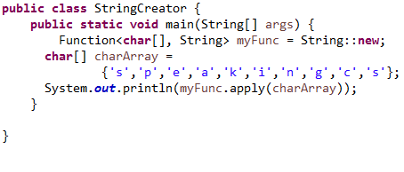
Application: Using map with Constructor References
String::new
//output: speakingcs
See Demo: lesson9.lecture.newstring
Note: In this case, String::new is short for the lambda expression charArray -> new String(charArray), which is a realization of the Function interface.

Slide 18
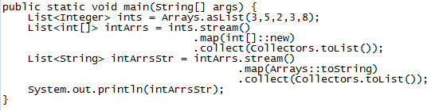
Application: Using map with Constructor References
int[]::new is another constructor reference, short for the lambda expression len -> new int[len] (where len is an integer that is used as the new array length)
Exercise: What is the following code doing? What is the output when it is run?
See Demo: lesson9.lecture.constructorref.IntArrayExample
Question: In this example, the list ints is turned into a stream – could we change the code so that we start with a stream of integers, using one of the stream operations iterate or generate?

Slide 19
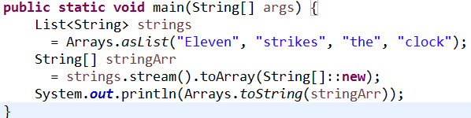
Application: Using map with Constructor References
Array constructor reference and the toArray method
If you have created a Stream<String>, we have seen how to output a List<String> from this stream, using collect (more on this later), but how to obtain an array String[]? A first try would be to provide a toArray method: Stream<String> stringStream = //… String[] vals = stringStream.toArray(); //compiler error
The toArray method exists, but produces an Object[], not a String[]. Can solve with a constructor reference:
String[] vals = stringStream.toArray(String[]::new);
Output: [Eleven, strikes, the, clock]
See Demo: lesson9.lecture.constructorref.GenericArray.
Output: [Eleven, strikes, the, clock]

Slide 20
Stream Operations, continued: Use flatMap to Transform Each Element of a Substream and Flatten the Result
We illustrate flatMap with an example:
Suppose we apply the characterStream method (see earlier slide) to each element of a list, using map:
List<String> list = Arrays.asList(“Joe”, “Tom”, “Abe”);
Stream<Stream<Character>> result = list.stream().map(s -> characterStream(s))
The Stream result looks like a list of lists: [[‘J’, ‘o’, ‘e’],[‘T’, ‘o’, ‘m’],[‘A’, ‘b’, ‘e’]].
“Flattening” this Stream means putting all elements together in a single list. This is accomplished using flatMap in place of map:
Stream<Character> flatResult = list.stream().flatMap(s -> characterStream(s))
Output in this case has been flattened: [‘J’, ‘o’, ‘e’, ‘T’, ‘o’, ‘m’, ‘A’, ‘b’, ‘e’].

Slide 21
Stateful Transformations
The transformations discussed so far – map, filter, limit, skip, concat – have been stateless: each element of the stream is processed and forgotten.
Two stateful transformations available from a Stream are distinct and sorted.
Example of distinct:
Stream<String> uniqueWords
= Stream.of("merrily", "merrily", "merrily", "gently").distinct();
//output: ["merrily", "gently"]
Example of sorted: (sorted accepts a Comparator parameter)
//sort by decreasing lengths of words
List<String> words = Arrays.asList("Tom", "Joseph", "Richard");
Stream<String> longestFirst
= words.stream().sorted((String x, String y) ->
(new Integer(y.length()).compareTo(new Integer(x.length()))));
System.out.println(longestFirst.collect(Collectors.toList()));
//output: Richard, Joseph, Tom
Note: This code uses some functional techniques, but notice that the Comparator still has the flavor of “how” rather than “what”.

Slide 22
Implementing Comparators with More Functional Style [see package lesson9.lecture.comparators1]
In previous example, we are seeking to sort “by String length”, in reverse order. Rather than specifying how to do that, we can use the new static comparing method in Comparator: Stream<String> longestFirst
= words.stream().sorted(Comparator.comparing(String::length).reversed());
Comparator.comparing takes a Function<T,U> argument. The type T is the type of the object being compared – in the example, T is String. The type U is the type of object that will actually be compared - since we are comparing lengths of words, the type U is Integer in this case.
Knowing these points makes it possible to write the call to sort even more intuitively. Function<String, Integer> byLength = x -> x.length(); //same as String::length
Stream<String> longestFirst
= words.stream().sorted(Comparator.comparing(byLength).reversed())

Slide 23
Implementing Comparators with More Functional Style
Note: reversed() is a default method in Comparator that reverses the order defined by the instance of Comparator that it is being applied to.
Another example of comparing function: Create a Comparator<Employee> that compares Employees by name, and another that compares by salary
Comparator<Employee> NameComparator = Comparator.comparing(Employee::getName);
Comparator<Employee> SalaryComparator = Comparator.comparing(Employee::getSalary);

Slide 24
Implementing Comparators with More Functional Style
Support for Comparators that are consistent with equals. (Review consistency with equals issue in lesson8.lecture.exercise.employeecode and also in Lab 8)
- Recall when we wanted to sort Employees (where an Employee has a name and a salary) by name, we needed to consider also the salary, or else the Comparator is not consistent with equals. Collections.sort(emps, (e1,e2) ->
{
if(method == SortMethod.BYNAME) {
return e1.name.compareTo(e2.name);
} else {
if(e1.salary == e2.salary) return 0;
else if(e1.salary < e2.salary) return -1;
else return 1;
}
});
- This approach is “how”-oriented, and can be made more declarative by using the
comparing and thenComparing methods of Comparator

Slide 25
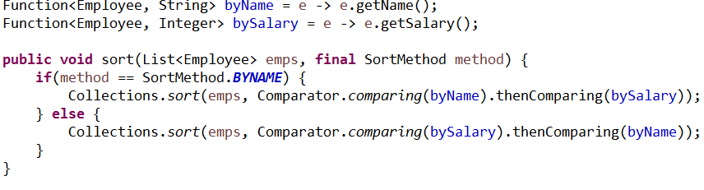
Implementing Comparators with More Functional Style
-
Notes:
comparing is a static method of Comparator, and therefore cannot be chained
thenComparing is a default method so can be chained; it modifies current Comparator by introducing its compare method just when the current compare method returns 0.
we can get rid of the if/else branching using a HashMap – see Lab 9, Problem 3.

Slide 26
Getting Outputs from Streams:
The last step in a pipeline of Streams is an operation that produces a final output – such operations are called terminal operations because, once they are called, the stream can no longer be used. They are also called reduction methods because they reduce the stream to some final value. We have already seen one example: collect(Collectors.toList())
count: Counts the number of elements in a Stream.
List<String> words = //…
int numLongWords = words.stream().filter(w -> w.length() > 12).count();
max, min, findFirst, findAny search a stream for particular values and will throw an exception if not handled properly. An easy way to handle: Example: max
Optional<String> largest = words.stream()
.max(String::compareToIgnoreCase);
if (largest.isPresent())
System.out.println("largest: " + largest.get());

Slide 27
Getting Outputs from Streams:
An Optional is a wrapper for the answer – either the found String can be read via get(), or a boolean flag can be read that says no value was found (for example, if the stream was empty).
You can call get() on an Optional to retrieve the stored value, but if the value was not found, so that the Optional flag isPresent is false, calling get()produces a NoSuchElementException.
Example: findFirst
Optional<String> startsWithQ
= words.stream().filter(s -> s.startsWith("Q")).findFirst();
Example: findAny This operation returns true if any match is found, false otherwise; this one works well with parallel streams:
Optional<String> startsWithQ
= words.parallelStream() .filter(s -> s.startsWith("Q")) .findAny();

Slide 28
Working with Optional – A Better Way to Handle Nulls
The previous slide introduced the Optional class. Optional was added to Java to make handling of nulls less error prone. However notice
if (optionalValue.isPresent()) optionalValue.get().someMethod();
is no easier than if (value != null) value.someMethod();
The Optional class, however, supports other techniques that are superior to checking nulls.

Slide 29
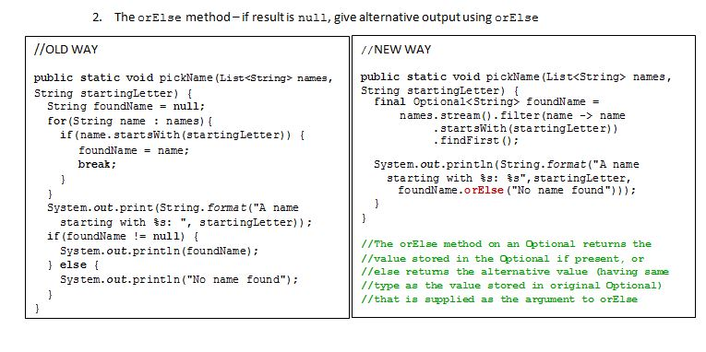
Working with Optional – A Better Way to Handle Nulls

Slide 30
Working with Optional – A Better Way to Handle Nulls
Use ifPresent(Consumer) to invoke an action and skip the null case completely.
public static void pickName(List<String> names, String startingLetter) {
final Optional<String> foundName =
names.stream()
.filter(name ->name.startsWith(startingLetter))
.findFirst();
foundName.ifPresent(name -> System.out.println("Hello " + name));
}
Question. Why did the Java creators insert a lambda as the argument for ifPresent here?
Notes:
Optional<User>.ifPresent() takes a Consumer<? super User> as argument. A Consumer is intended to be implemented as a lambda expression:

Slide 31

Creating Your Own Optionals
Using of and empty. You can create an Optional instance in your own code using the static method of. However, if of is used on a null value, a NullPointerException is thrown, so the best practice is to use of together with empty, as in the following:
Optional.empty() simply creates an Optional with no wrapped value; in that case, the isPresent flag is set to false.
Using ofNullable The static method ofNullable lets you read in a possibly null value (unlike of) (read “ofNullable” as “do of but also allow nulls”).
Can use orElse and Optional.ofNullable together, as an alternative to the following pattern (typical example of this pattern is getting a JDBC Connection)
“If X is null, populate X, then return X.”
NOTE: ofNullable returns an Optional that embeds the specified value if non-null, otherwise returns an empty Optional

Slide 32
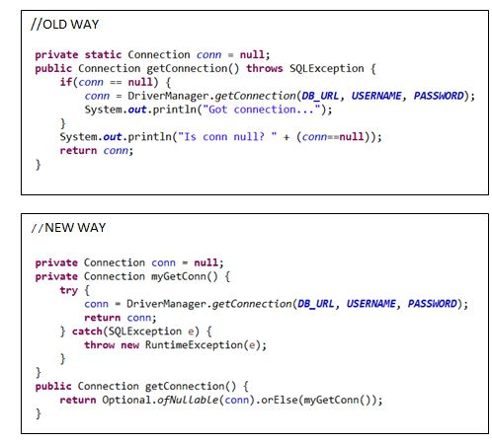
Creating Your Own Optionals

Slide 33

The reduce Operation
The reduce operation lets you combine the terms of a stream into a single value by repeatedly applying an operation.
Example We wish to sum the values in a list of numbers. Procedural code:
Using the reduce operation, the code looks like this:
First argument is an initial value; it is the value that is returned if the stream is empty (it is also the identity element for the combining operation). The second argument is a lambda for BinaryOperator<T>
interface BinaryOperator<T> { T apply(T a, T b); }

Slide 34
The reduce Operation
Applied to a list of numbers, this reduce operation returns the sum of all the numbers. The initial value makes sense here because the “sum of an empty set of numbers is 0”.
The initial value is also used to produce the final computation. For example, if numbers is [2,1,4,3], then the reduce method performs the following computation:
(((0 + 2) + 1) + 4) + 3 = 10
A parallel computation can improve performance. Say [2,1,4,3] is broken up into [2,3],[4,1]. Then in parallel we arrive at the same answer in the following way:
sum1 = (0 + 2) + 3 sum2 = (0 + 4) + 1 combined = sum1 + sum2 = 10
How could we form the product of a list of numbers?

Slide 35
The reduce Operation
Example We form the product of a list numbers of numbers. For the initial value, we ask, “What is the product of an empty set of numbers?” By convention, the product is 1. (Note that 1 is the identity element for multiplication.) Here is the line of code that does the job:
Example. What about subtraction? What happens when the following line of code is executed? Try it when numbers is the list [2, 1, 4, 3].
int difference = numbers.stream().reduce(0, (a, b) -> a - b);
Here, the computation proceeds like this: (((0 – 2) – 1) – 4) – 3) //output: -10

Slide 36
The reduce Operation
The problem here is that performing this computation in parallel gives a different result; subtractions are grouped differently for a parallel computation. For instance, during parallel computation, if [2,1,4,3] is broken up into [2,3] and [4,1], the computation would look like this:
diff1 = (0 – 2) – 3 diff2 = (0 – 1) – 4 combined = diff1 - diff2 = 0
For this reason, a requirement concerning reduce is:
Only use reduce on associative operations.
(Note that + and * are associative, but subtraction is not.) See the demo lesson9.lecture.reduce.

Slide 37
The reduce Operation
The reduce method has an overridden version with only one argument.
Continuing with the sum example, here is a computation with the overridden version:
This version of reduce produces the same output as the earlier version when the stream is nonempty, but it is stored in an Optional in this case. When the stream is empty, the reduce operation returns a null, which is again embedded in an Optional.

Slide 38
Main Point 1
When a Collection is wrapped in a Stream, it becomes possible to rapidly make transformations and extract information in ways that would be much less efficient, maintainable, and understandable without the use of Streams. In this sense, Streams in Java represent a deeper level of intelligence of the concept of “collection” that has been implemented in the Java language.
When intelligence expands, challenges and tasks that seemed difficult and time-consuming before can become effortless and meet with consistent success. This is one of the documented benefits of TM practice.

Slide 39
Collecting Results
One kind of terminal operation in a stream pipeline is a reduction that outputs a single value, like max or count. Another kind of terminal operation collects the elements of the Stream into some type of collection, like an array, list, or map. We have seen examples already. Example: Collecting into an array
String[] result = words.toArray(String[]::new);
Example: Collecting into a List
List<String> result = stream.collect(Collectors.toList());
Example: Collecting into a Set
Set<String> result = stream.collect(Collectors.toSet());
Example: Collecting into a particular kind of Set (same idea for particular kinds of lists, maps) TreeSet<String> result = stream.collect(Collectors.toCollection(TreeSet::new));
Example: Collect all strings in a stream by concatenating them: String result = stream.collect(Collectors.joining());
//separates strings by commas
String result = stream.collect(Collectors.joining(", "));
//prepares objects as strings before joining
String result = stream.map(Object::toString).collect(Collectors.joining(","));
Note: Here instead of Object::toString you can use your own object type, like
Employee::toString. By polymorphism, either way works. See demo lesson9.lecture.collect

Slide 40
Collecting Results
Example: Collecting into a map – two typical examples. Here, people is a Stream of Person objects.
//key = id, value = name
Map<Integer, String> idToName
= people.collect(Collectors.toMap(Person::getId, Person::getName));
//key = id, value = the person object
Map<Integer, Person> idToPerson
= people.collect(Collectors.toMap(Person::getId, Function.identity()));
NOTE: identity is a static method on Function that returns a function that always returns its input argument. In the example, it is the function (Person p) -> p

Slide 41
Collecting Results
Example: Collecting “summary statistics” for int-valued streams, providing sum,average, maximum, and minimum
IntSummaryStatistics summary
= words.collect(Collectors.summarizingInt(String::length));
double averageWordLength = summary.getAverage();
double maxWordLength = summary.getMax();
Similar SummaryStatistics classes are available for Double and Long types too: DoubleSummaryStatistics uses Collectors.summarizingDouble; LongSummaryStatistics uses Collectors.summarizingLong.
Note: IntSummaryStatistics extracts int information from an input Stream. The elements of the Stream must therefore be converted to (primitive) ints in order for summarizingInt to perform its tasks.
SummarizingInt expects an implementation of the ToIntFunction<T> interface:
interface ToIntFunction<T> { int applyAsInt(T value); }
In the example, notice String::length is a realization of this interface: str -> str.length()

Slide 42
Can Streams Be Re-Used?
Once a terminal operation has been called on a stream, the stream becomes unusable, and if you do try to use it, you will get an IllegalStateException.
But sometimes it would make sense to have a Stream ready to be used for multiple purposes.
Example: We have a Stream<String> that we might want to use for different purposes:
Folks.friends.stream().filter(name -> name.startsWith(“N”))
We may want to count the number of names obtained for one purpose, and output the names in upper case to a List, for another purpose. But once the stream has been used once, we can’t use it again.
Solution #1 One solution is to place the stream-creation code in a method and call it for different purposes. See Good solution in package lesson9.lecture.streamreuse
Solution #2 Another solution is to use a higher-order lambda to capture all the free variables in the first approach as parameters of some kind of a Function (might be a BiFunction, TriFunction, etc, depending on the number of parameters). See Reuse solution in package lesson9.lecture.streamreuse

Slide 43
Primitive Type Streams
Streams cannot be used directly with primitive types, but there are variations of Stream that are specifically designed for primitives: int, double, and long. They are, respectively, IntStream, DoubleStream, and LongStream. To store primitive types short, char, byte, and boolean, use IntStream; to store floats, use DoubleStream.
Points about IntStream:
Creation methods are similar to those for Stream:
IntStream ints = IntStream.of(1, 2, 4, 8);
IntStream ones = IntStream.generate(() -> 1);
IntStream naturalNums = IntStream.iterate(1, n -> n+1);
IntStream (and also LongStream) have static methods range and rangeClosed that generate integer ranges with step size one:
// Upper bound is excluded
IntStream zeroToNinetyNine = IntStream.range(0, 100); // Upper bound is included
IntStream zeroToHundred = IntStream.rangeClosed(0, 100);

Slide 44
Primitive Type Streams
To convert a primitive type stream to an object stream, use the boxed() method: Stream<Integer> integers = IntStream.range(0, 100).boxed();
Stream<String> words = ...;
IntStream lengths = words.mapToInt(String::length);
To convert an object stream to a primitive type stream, there are methods mapToInt, mapToLong, and mapToDouble. In the examples, a Stream of strings is converted to an IntStream (of lengths). Stream<String> words = ...;
IntStream lengths = words.mapToInt(String::length);

Slide 45
Primitive Type Streams
The methods on primitive type streams are analogous to those on object streams. Here are the main differences:
The toArray methods return primitive type arrays.
Methods that yield an optional result return an OptionalInt, OptionalLong, or OptionalDouble. These classes are analogous to the Optional class, but they have methods getAsInt, getAsLong, and getAsDouble instead of the get method.
There are methods sum, average, max, and min that return the sum, average,maximum, and minimum. These methods are not defined for object streams. (Note that the functions max and min defined on an ordinary Stream, require a Comparator argument, and return an Optional.)

Slide 46
Creating a Lambda Library
One of the biggest innovations in Java 8 is the ability to perform queries to extract or manipulate data in a Collection of some kind. Combining the use of lambdas and streams, one can almost always obtain the same efficient query statements one could expect to formulate using SQL (to obtain similar results).
Database Problem. You have a database table named Customer. Return a collection of the names of those Customers whose city of residence begins with the string “Ma”, arranged in sorted order.

Slide 47
Creating a Lambda Library
Solution. SELECT name FROM Customer WHERE city LIKE 'Ma%' ORDER BY name
Java Problem: You have a List of Customers. Output to a list, in sorted order, the names of those Customers whose city of residence begins with the string “Ma.”
Solution.
List<String> listStr = list.stream()
.filter(cust -> cust.getCity().startsWith("Ma"))
.map(cust -> cust.getName()) .sorted()
.collect(Collectors.toList());

Slide 48
Turning Your Stream Pipeline into a Library Element
To turn the Java solution in the previous slide into a reusable element in a Lambda Library, identify the parameters that are combined together in your pipeline, and consider those to be arguments for some kind of Java function-type interface (Function, BiFunction, TriFunction, etc).
Parameters:
An input list of type List<Customer>
A target string used to compare with name of city, of type String
Return type: a list of strings: List<String>
These suggest using a BiFunction as follows:
public static final BiFunction<List<Customer>, String, List<String>> NAMES_IN_CITY
= (list, searchStr) -> list.stream() .filter(cust -> cust.getCity().startsWith(searchStr))
.map(cust -> cust.getName())
.sorted()
.collect(Collectors.toList());

Slide 49
Connecting the Parts of Knowledge With the Wholeness of Knowledge
Prior to the release of Java 8, extracting or manipulating data in one or more lists or other Collection classes involved multiple loops and code that is often difficult to understand.
With the introduction of lambdas and streams, Java 8 makes it possible to create compact, readable, reusable expressions that accomplish list-processing tasks in a very efficient way. These can be accumulated in a Lambda Library.
Transcendental Consciousness is the field that underlies all thinking and creativity, and, ultimately, all manifest existence.
Impulses Within the Transcendental Field. The hidden self-referral dynamics within the field of pure intelligence provides the blueprint for emergence of all diversity. This blueprint is formed from compact expressions of intelligence coherently arranged.
Wholeness Moving Within Itself. In Unity Consciousness, the fundamental forms out of which manifest existence is structured are seen to be vibratory modes of one’s own consciousness.

